Slide 1
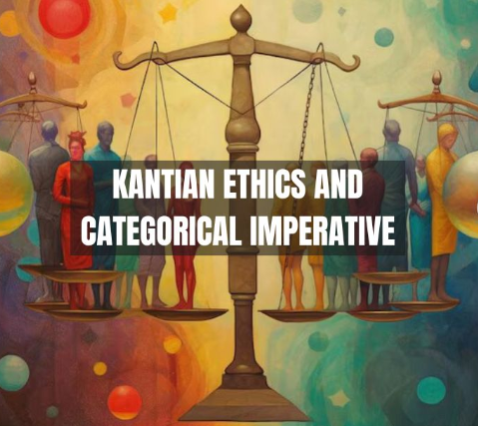
Discussion Assignment Unit 6
Kantian ethics

Slide 2
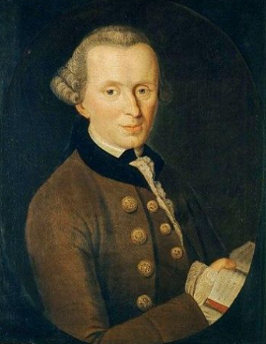
Introduction
My name is Godfrey Ouma, and I would like to present to you application of Kantian ethics to evaluate “Falsifying information at work.”
Immanuel Kant's ethical theory, known as Kantian ethics, centers around the categorical imperative, a moral rule based on rationality. It emphasizes duties and obligations, focusing on the intentions behind actions and the inherent worth of rational beings.
Kant argues that moral principles must be universal and derived from reason, regardless of consequences (Matthews & Hendricks, 2019).
Immanuel Kant (1724-1804)

Slide 3
Kant's categorical imperative
The first formulation of the categorical imperative states that we should act only on maxims that we can will as universal laws.
The second formulation emphasizes treating individuals as ends rather than means.
The third formulation envisions a world where everyone follows the categorical imperative (Matthews & Hendricks, 2019).

Slide 4
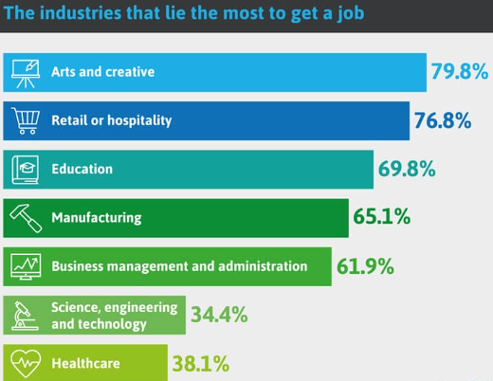
Falsifying information at work
My scenario for this assignment is falsifying information at work. Cambridge Dictionary (2024) defines falsification as “The action of changing something, such as a document, in order to deceive people.”
Falsification is not a new term at workplaces during recruitment as Mancini (2024) reports that over 50% of job seekers lying on resumes to convince employers to hire them.

Slide 5
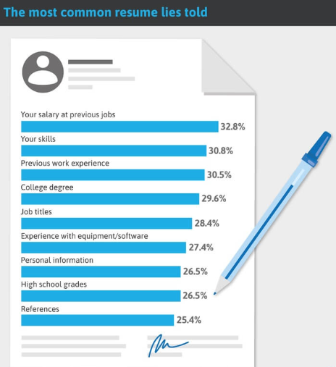
Reason for falsifying information at work
To justify the rational for falsifying information at work, 56% of respondents surveyed by StandOut CV revealed that the rising cost of living prompt them to lie on a resume when applying for a job (Fennell, 2024).
Mancini (2024) further reports that 32.8% of job applicants lie about their salary at previous jobs, which is the most common thing people lie about.
This presentation evaluates falsifying information at work by lying about salaries at previous jobs due to high cost of living in the light of each of the three formulations of Kant's categorical imperative.

Slide 6
Analysis using first formulation of Kant's categorical imperative
Evaluating the scenario in the light of the first formulation of Kant's categorical imperative would conclude that this action contradicts the principle of universalization.
According to this principle, one should act only on maxims that can be accepted as a universal law (Matthews & Hendricks, 2019). If everyone were to falsify information to secure jobs, the practice would lead to chaos, rendering job qualifications meaningless.
As a result, Kant's categorical imperative would consider falsifying information at work by lying about salaries due to high cost of living as wrong because it fails the test of universality.

Slide 7
Analysis using second formulation of Kant's categorical imperative
Similarly, the scenario can also be evaluated in the light of Kant's second formulation of the categorical imperative. According to Kant's philosophy, treating humans as an end, not merely a means, is crucial (Matthews & Hendricks, 2019).
By falsifying information at work by lying about salaries due to high cost of living, individuals might be using the employer as a means to an end—meeting their family's basic needs—without fully respecting the humanity of the employer.
This could be viewed as a violation of the dignity of the employer as a rational being. From Kant's perspective, such actions would be considered morally wrong.

Slide 8
Analysis using third formulation of Kant's categorical imperative
Finally, the scenario can also be viewed through the lens of the third formulation of Kant's categorical imperative, which refers to a "systematic union of various rational beings through common laws." Kant emphasizes that this systematic union highlights the necessity of moral autonomy and equal standing among rational beings (Matthews & Hendricks, 2019).
Thus, such an action could be viewed as not aligning with Kant's third formulation, as it involves dishonesty and deception, which can undermine the trust and rational harmony essential in a kingdom of ends.
Therefore, Kantian ethics would disapprove of falsifying work information, despite the noble intention to meet family needs.

Slide 9
Conclusion
Falsifying work information by lying about previous salaries due to high cost of living contradicts Kant's categorical imperative, making it morally wrong.
Over 50% of job seekers lie on resumes to secure employment, and the most common falsification is about previous salaries.
Falsification at work undermines trust and rational harmony, thus violating Kant's emphasis on moral autonomy and equal standing among rational beings.
In conclusion, Kantian ethics disapproves of falsifying work information, despite the noble intention to meet family needs.

Slide 10


Slide 11
References
Cambridge Dictionary. (2024). Falsification. Cambridge Dictionary | English Dictionary, Translations & Thesaurus. https://dictionary.cambridge.org/dictionary/english/falsification
Fennell A. (2024, December 19). Study: Fake job references and resume lies. StandOut CV | Create a winning CV in minutes with our simple CV builder. https://standout-cv.com/usa/stats-usa/study-fake-job-references-resume-lies
Mancini, M. (2024, February 20). Over half of employees report lying on resumes. HRO Today. https://www.hrotoday.com/news/over-half-of-employees-report-lying-on-resumes/#:~:text=The%20most%20common%20thing%20people,and%20employer%20references%20(25.4%25)
Matthews, G., & Hendricks, C. (2019). Introduction to philosophy: Ethics. Rebus Community. https://open.umn.edu/opentextbooks/textbooks/introduction-to-philosophy-ethics Licensed under CC 4.0

